Slide 1

DETECTION OF DDoS (Distributed Denial of Service) ATTACK ON SDN CONTROL PLANE USING HYBRID MACHINE LEARNING TECHNIQUE
Batch 05
Guided By:
Mrs Sougandhika Narayan
Assistant Professor
Dept of CSE, KSIT
Dakaraju Viswateja | 1KS16CS018
Keerthi M | 1KS16CS032
Manipi Manoj | 1KS16CS039
Kiran Kumar M | 1KS16CS034

Slide 2

Project Title
Detection of DDoS attack on SDN Control plane using Hybrid Machine Learning Technique

Slide 3

SDN Environment
Software Defined Network (SDN) provides a promising solution over traditional networks by decoupling the control plane and network plane. With the help of this feature, controller can get global view of the entire network.
SDN architecture separates the network control from forwarding devices and enables the controller to become directly programmable.
This helps the network administrators to adjust the network traffic flow dynamically. Due to its centralized nature, controller can get a global view of the network

Slide 4
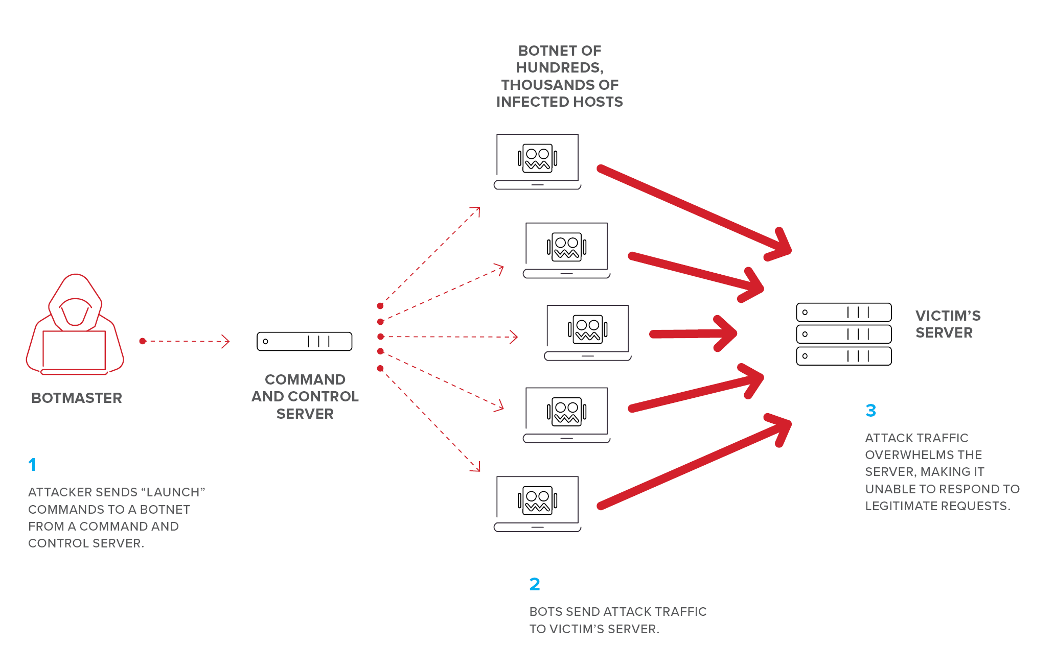
A DoS (Denial of Service) Attack
The main idea of a DoS attack is making a certain service unavailable.
Since every service is in reality, running on a machine, the service can be made unavailable if the performance on the machine can be brought down.
This is the fundamental behind DoS and DDoS

Slide 5
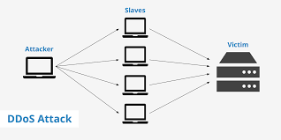
A DDoS (Distributed Denial of Service) Attack
A Denial of Service (DoS) attack is different from a DDoS attack.
The DoS attack typically uses one computer and one Internet connection to flood a targeted system or resource.
The DDoS attack uses multiple computers and Internet connections to flood the targeted resource.

Slide 6
Hybrid Machine Learning(SVM & SOM):
Hybrid Machine Learning is combination of two Learning alogrithms
In our project we are using SVM (Support Vector Machine) & SOM (Self Organizing Map) algorithms in combination to classify the botnet’s and normal connections.
Where SOM is an unsupervised learning algorithm it gives a particular x accuracy, where as SVM being supervised learning algorithm gives < x accuracy.
In which the combination of both algorithms gives an accuracy > x.

Slide 7
Overview of Project
The major threat in networking environments is DDoS attack. DDoS attack is the most potential attack in SDN environment.
DDoS attack prevents the authorized user to access the available resources for infinite amount of time. In this attack, attacker tries to compromise the multiple number of hosts to send a huge amount of traffic intentionally towards a legitimate user.
A host which is under the attacker control is called Bot. A group of controlled computers is known as BotNet.
This project is all about designing a DDoS detection mechanism based on Hybrid Machine Learning Technique to protect the controller from DDoS attacks.

Slide 8
Project Goals
In this project a hybrid Machine Learning technique will be developed which detects the bots (major cause for DoS Attack).
In SDN Environment, the wireshark monitor with the help of this ML technique detects the bots that cause a DDoS attack from multiple sources.
Which finally detects DDoS attacks on web servers.

Slide 9
Project Applications
As this project mainly prevents the DDoS attacks, hence this project can be used in several web servers to prevent the unnecessary flooding of unknown traffic.

Slide 10

Requirements:
Operating system | : Linux based System with 4 GB RAM
Coding Language | : Python
Technology | : Machine Learning
Tools | : WireShark, Minimet,Scapy

Slide 11

References:
Base Paper : International Conference on Smart Systems and Inventive Technology (ICSSIT 2018)IEEE Xplore Part Number: CFP18P17-ART; ISBN:978-1-5386-5873-4
-V.Deepa, K.Muthamil Sudar, P.Deepalakshmi
Department of Computer Science and Engineering
Kalasalingam Academy of Research and Education, Krishnankoil
E-Learning Site :Edureka (Cyber Security),NPTEL (Ethical Hacking)

Slide 12
THANK YOU

